Slide 1


Google Machine Learning courses Introduction

Slide 2




Notes:
https://www.youtube.com/channel/UC35ZpwldGw7ZJ5R-2sLijzw

Slide 3

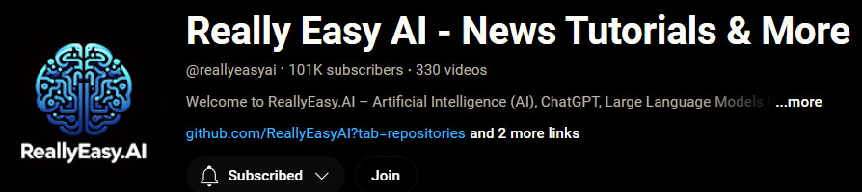
Membership has its privileges
Notes:
https://www.youtube.com/channel/UC35ZpwldGw7ZJ5R-2sLijzw/join

Slide 4

https://www.youtube.com/@AINewsFresh

Slide 5
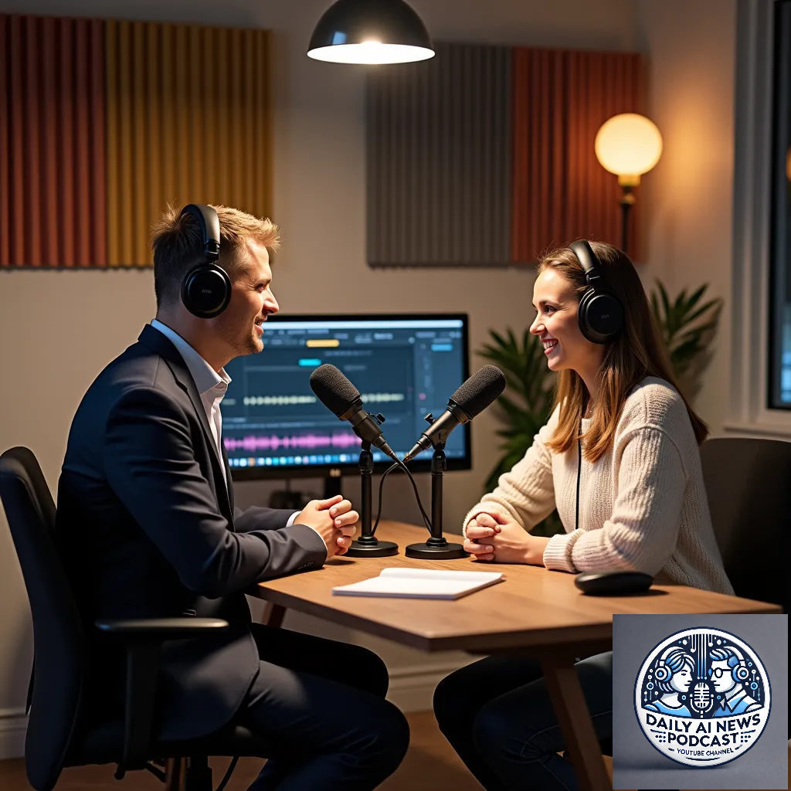
https://www.youtube.com/@DailyAINewsPodcast

Slide 6

https://www.youtube.com/@AIPapersPodcastDaily

Slide 7
